Slide 1

Empowering and Engaging Youth as a Positive Force for Transformational Change in Somalia
Transformative Peace Initiatives using TOCfE tools
____________________
Sharmarke Yusuf
Cohort 2
Somalia, 2022

Slide 2

Problem statement
The intervention - Proposal
70 % of Somalia’s population under 30 years old
Somalian youth face uncountable economic and social challenges.
Somali Institute for Development Research SIDRA 2019 report
verifies the existence of the youth radicalization in Somalia has
major impact on the country’s insecurity
Violent extremist groups target youth to carry out extremist
cruel Ideology and carry out missions against stability and humanity
Empower 20 youth through transformative peace initiative to prevent radicalization
Enable positive thinking and growth mindset through participatory method called “Theory of Constraints”
Provide highly effective logical thinking and communication tools for behavioral change and conflict resolution
Enable participants to virtualize the consequences of their actions to ensure positive outcomes.

Slide 3


Challenges and mitigation strategy
Ambitious target tree were used to identify challenges and create an effective plan to overcome the obstacles that block achieving a successful implementation of the intervention (SCI)
AMBITIOUS TARGET
OBSTACLES | OBJECTIVES | Plan/ACTIONS
Lack of training facility and venue availability | Well-equipped and comfortable venues are available to conduct training | Engaged with Local organization and Universities to provide comfortable hall
lack of sufficient funds to conduct the project | secure sufficient funds to conduct training | Wrote a grant request to appropriate partners, support from Kathy Suerken
Insecurity incidents occurs in Mogadishu | Shift the intervention in to a relatively peaceful cities
Lack of training manuals and designed power point to deliver TOC Education tools | training materials were donated by the Mid-Bay Rotary Club’s Pathways to Peace through Pathways to peace and written by Kathy Suerken

Slide 4



Support and Facilities Received
Mentoring and guidance
Training Materials donated through Mid-Bay Rotary Club’s ‘Pathways to Peace’ project and written by Mid-Bay Peace Project Director and District 6940 Peace Fellow Chair.
Fund donations from Rotary Club of Mid-Bay Bridge
Kathy Suerken
District 6940 Peace Fellow Chair; President of TOCfE a non profit foundation (US 501c3)
TOC for Education, Inc. (TOCfE) Provided certificates for the participants and donated knowledge
TOC
Continues follow-up, updates and experience sharing with other Peace Fellows
for Education Inc

Slide 5
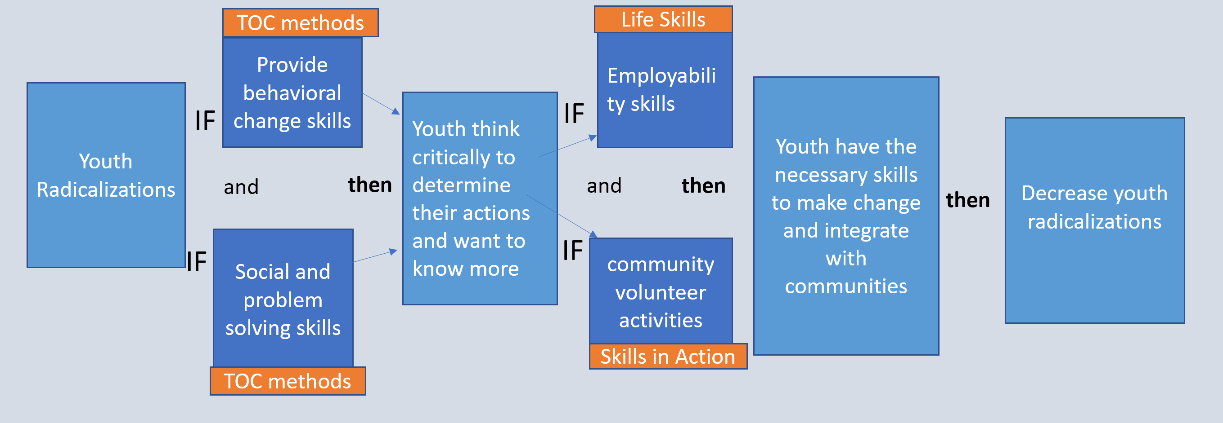
Theory of Constraints (TOC) “Dr. Eliyahu M. Goldratt (1947-2011)” is a set of thinking processes along with common sense methodologies used to logically identify and overcome key limitations.
The process provides tools to identify and overcome obstacles in creating favorable change and enable youth and other practitioners to think critically and logically for making positive, responsible decisions.
Theory of Change

Slide 6
Theory of Change – continued
TOC tools were effective in preventing youth radicalizations by identifying constrains, challenging problems and improving a situation resulting in positive decisions by answering three promising:
What to Change?
Defining the problem to address (Youth radicalizations);
What to Change to?
The solution--The intended change (Youth as positive peace agents);
How to Cause the Change?
How to implement the solution (A Powerful methodology that includes the Cloud, Branch and Ambitious Target Tree thinking and communication tools.)

Slide 7
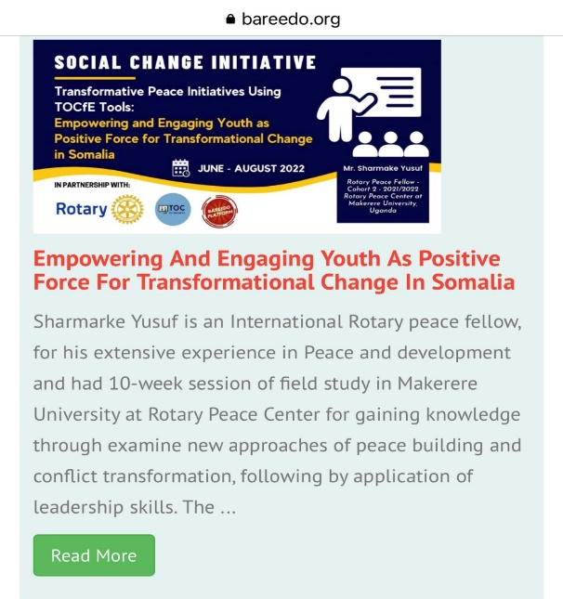
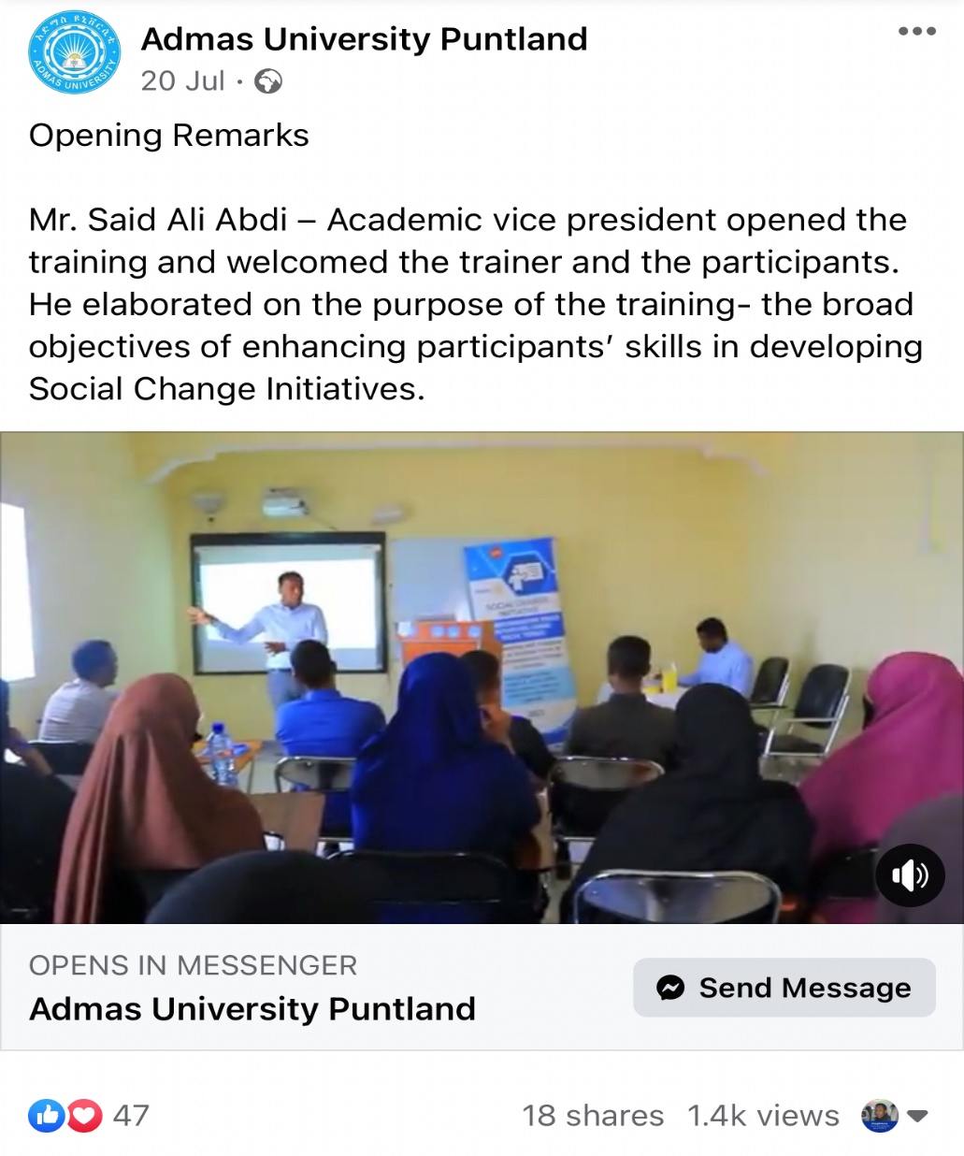
Interventions – outreach
Several organizations including Bareedo platforms and local universities were posted about the intervention for reaching out to the youth and to provide wider understanding of the program.
The online viewers of the intervention reached 1.4K views.
The peace fellow received a lot of request messages from youth around the country to join the intervention

Slide 8
Measuring the change and impact
Pre and post questionnaires were used in order to identify and measure the extent to which the intervention had impact on the behavioral change and attitudes. Participants were asked to indicate their opinions or feelings about fighting and respect as well as their perceptions about peace and conflict. The questionnaires were also use to measure their critical thinking skills to: resolve conflicts; identify obstacles; make positive decisions; use finger point language in arguments, and to have a win-win solution mindset

Slide 9
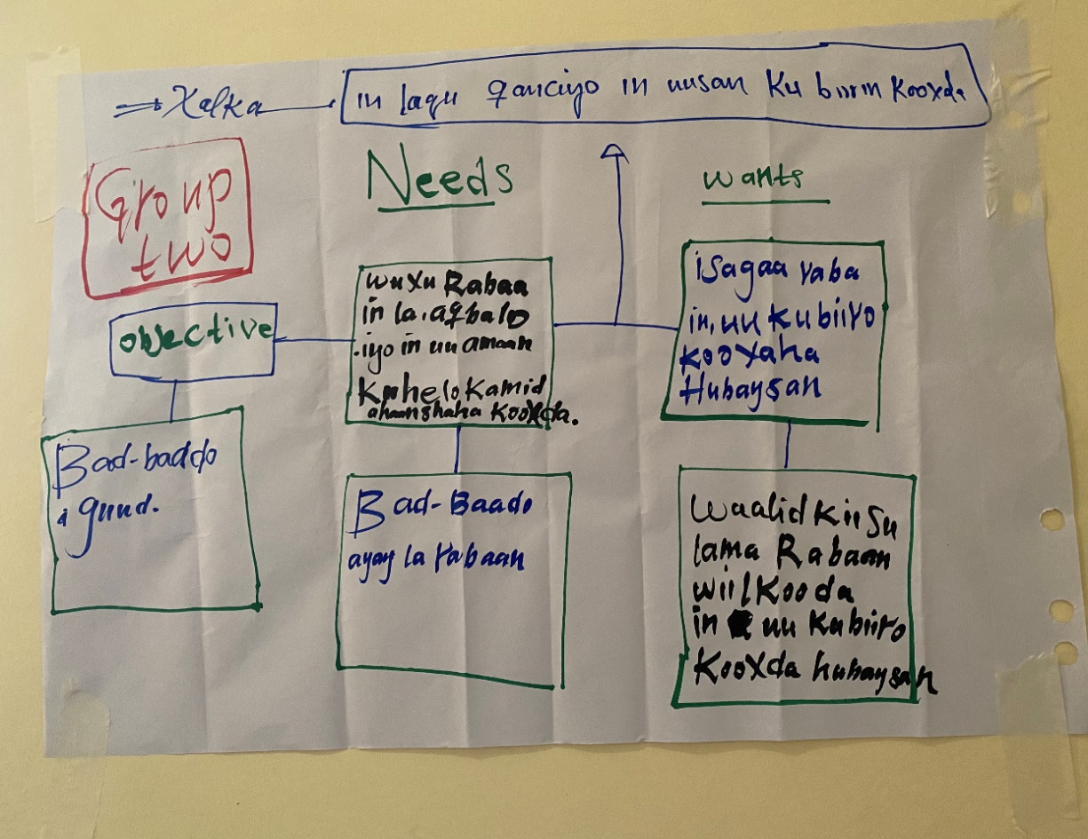
Case study 1- TOCfe tools the Cloud
One of the youth ( the name is not mentioned) wants to join to extremist groups somewhere in Somalia although his family doesn’t want him to a be a member of extremist groups because he maybe killed or targeted by the government forces and family can be at risk.
A group of participants were asked to solve a problem of one of them and their friends by using TOCfE tools; The group come back drawing and using Cloud to prevent a young person who wants to join extremist groups but his family doesn't want him to join those groups.
He wants to join an armed groups
He needs to be accepted and be safe within group
Safe and happy life
His family doesn’t want him to join to an armed group
They need Safety
After discussion, the group (and youth not mentioned) decided the he should not join armed groups as being in armed group does not assure safety and would put family at risk.

Slide 10
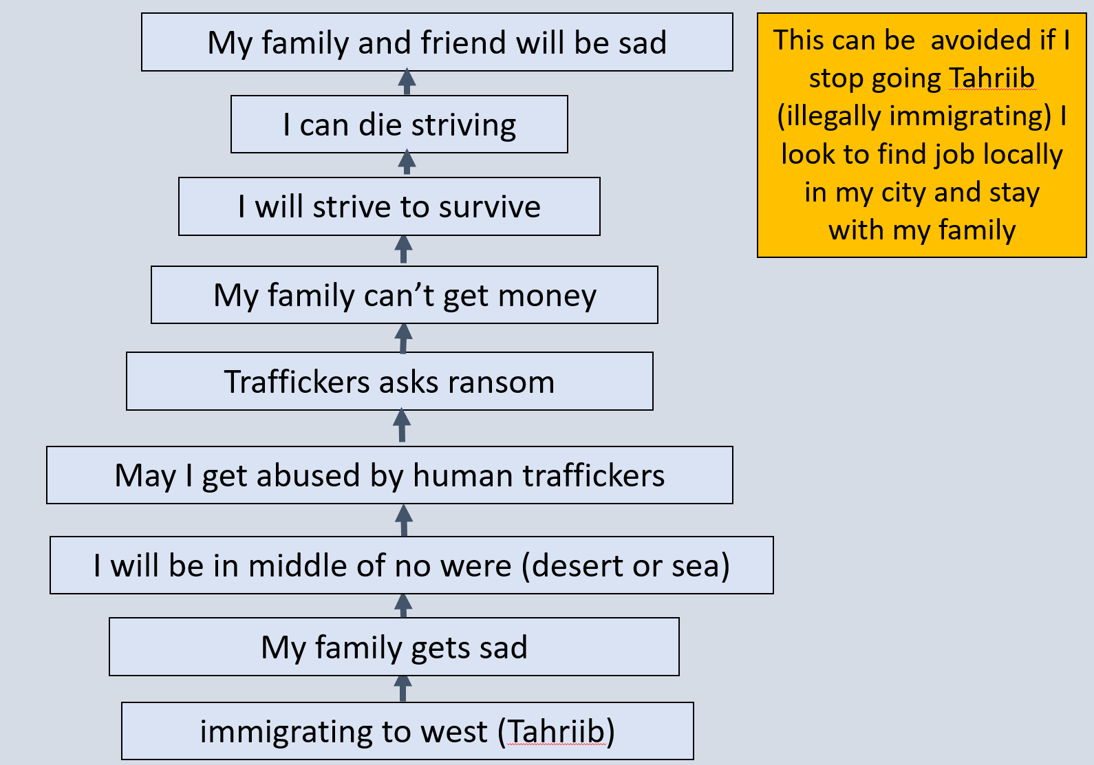
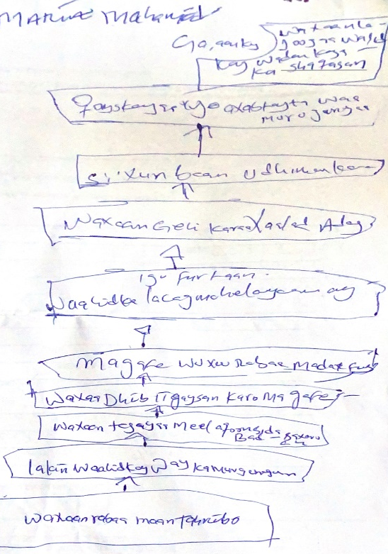
Case Study 2:
For more than two decades Somalia is losing many young generation through the process of TAHRIB, which means trafficking or illegal journey to western countries. Youth use this dangerous strategic to escape unemployment, lack of education, conflicts and armed groups.
Maryan was one of those youth who had dreams of a good life, education and enjoying basic human rights by reaching western world but where a lot of them ended up in the sea and desert by taking a big risk to reach there.
But, this time, her mindset is not like the one she had before as she had an opportunity to use TOCfE tools to thinking critically, identify the consequences of the negative decision and see the result before the negative action is taken. Instead, she made her decision based on the analysis of information. Imagining the consequences of the actions, she drew the following Branch.

Slide 11
Target: To Become Peace Agents
No | Obstacles | Intermediate objectives
1 | We haven’t mastered about peace | Attend workshop / further Peace trainings
2 | Limited facilities to reach more communities | Use internet and social media
3 | Vulnerability to insurgency groups | Limit the popularity, we don’t use logs
4 | Lack of youth public spaces | Liaise with universities and learning institutions
5 | Police are not friendly | We collaborate with local NGOs and Ministry of youth to recognize our peace initiatives and activities
6 | We need time and resources to facilitates our peace activities | We meet once a month to update and work at weekends to volunteer
7 | We need more skills and capacity building | Use TOC for education and request more training for the peace fellow, TOC Practitioners
8 | Communities may not listen to us | Prepare to show them the positive changes for peace initiative
9 | Adults are not tending to listen our peace initiatives | We can start to visit schools and engages peers

Slide 12
Conclusion
Conclusion and Recommendation
The TOCfE tools guide the practitioners through the decision-making process of problem structuring, identification of barriers to be overcome, solution building and implementation of the solution.
The participants of the initiatives demonstrated the best usage of the TOC tools on identification of the cause of radicalization and ways to overcome the drivers of youth to armed groups.
Recommend
To extend the inclusion of TOCfE in modules taught for Rotary peace fellows program that would provide peace fellows ability to apply TOCfE tools in their peace initiatives.
To allocate resources and funds for the SCI implementations
Since the problem of youth radicalization and gang warfare is becoming more a universal concern and, given the success of this initiative, it is recommended that there be more investment in youth engagement and soft skills not only to prevent youth radicalization but also to empower them with tools and the will to unleash their potential as peace agents now and in the future

Slide 13
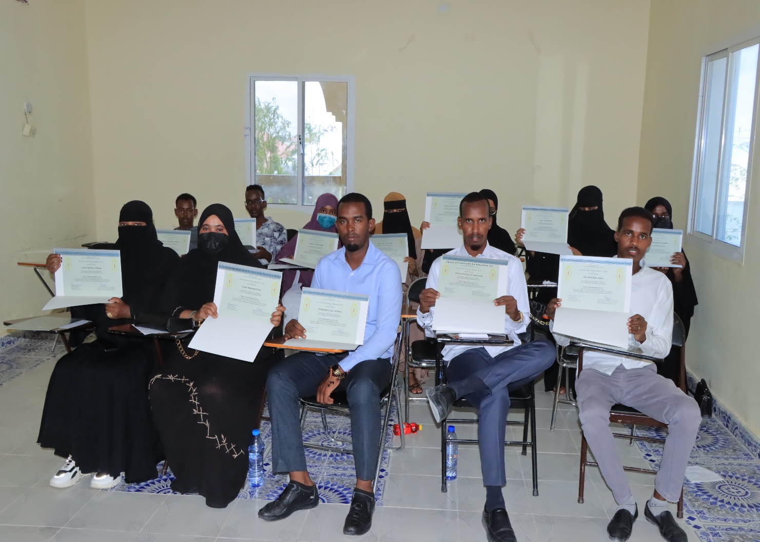
sustainability
The SCI Participants have formed a volunteer network to continue and train other peers for peace building and conflict resolution using theory of constrains tools and to continue spreading the culture of peace after the end of the initiatives.
Reducing youth radicalization enhances peace and security in the country and neighboring countries.

Slide 14


